Slide 1
Melanoma : ESMO Update 2019
Dr.Nidal KHEDER
Head of oncology department
Ibn-alnafis Hospital – Damascus
05-12-2019

Slide 2
Advanced Melanoma

Slide 3
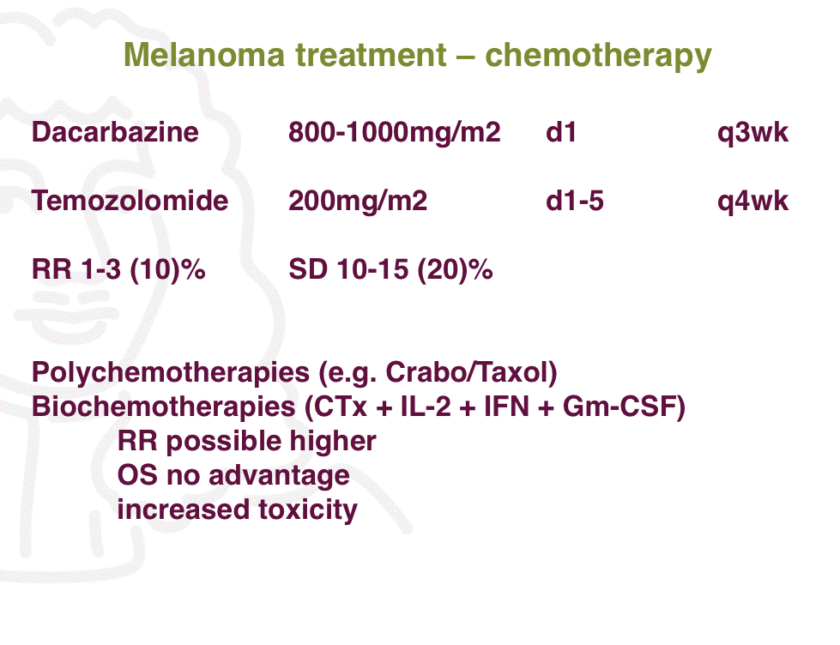

Slide 4
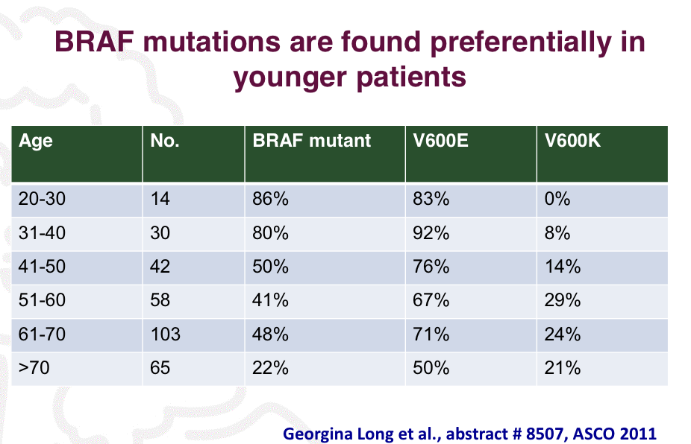

Slide 5
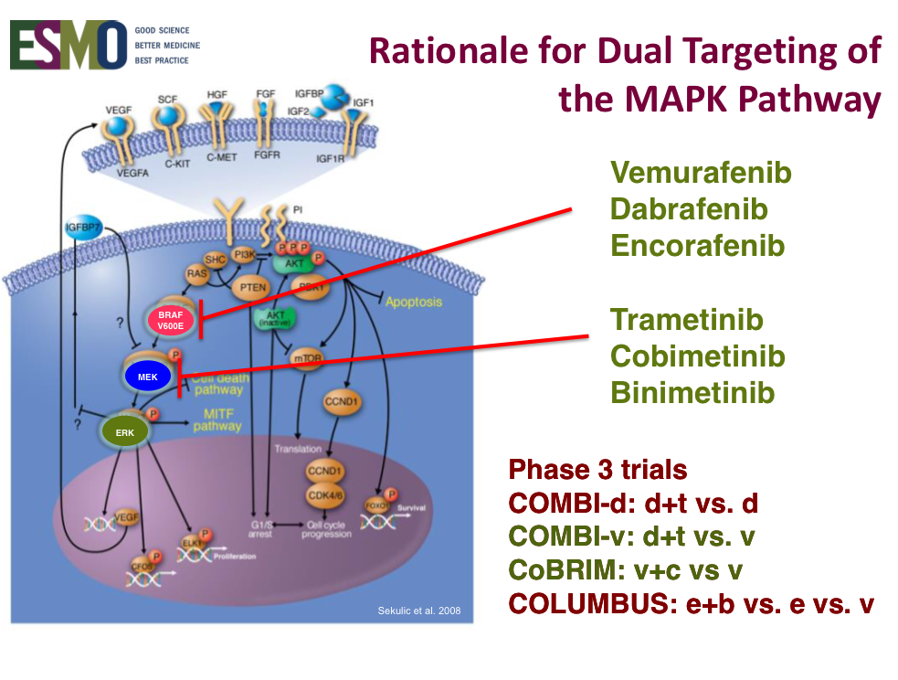

Slide 6
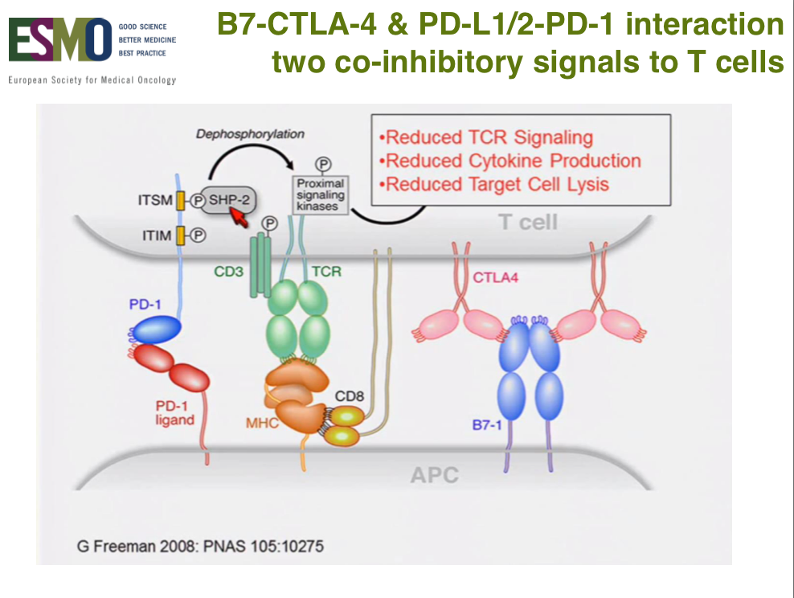

Slide 7
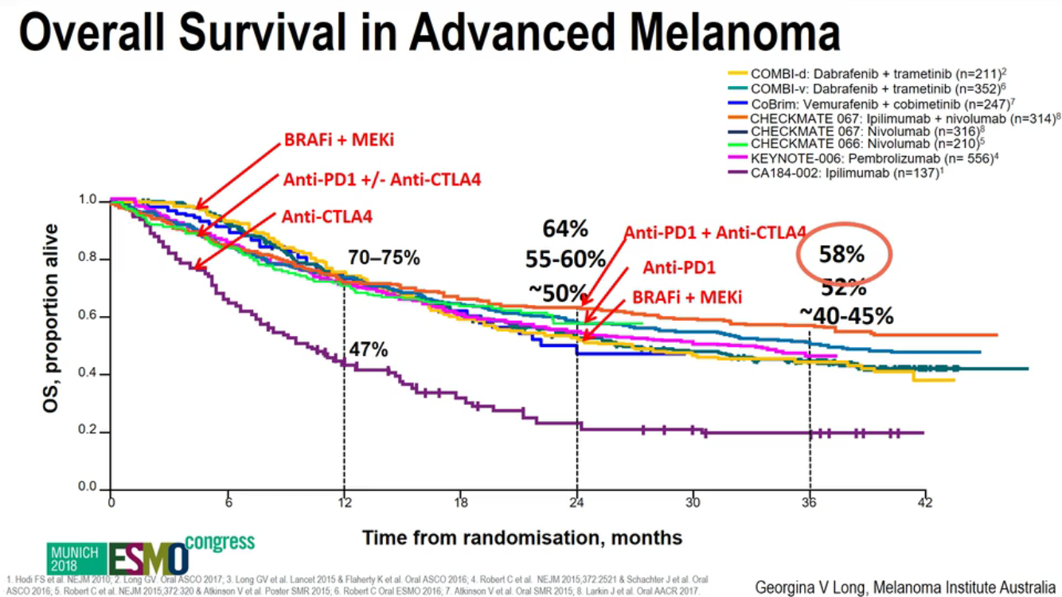

Slide 8
Advanced Melanoma
1- 5 year landmark survivals ipi+nivo vs nivo
2- Dosing regimen of combined ipi+nivo
3- Checkpoint inhibitors + BRAFi + MEKi

Slide 9
Advanced Melanoma
1- 5 year landmark survivals ipi+nivo vs nivo
2- Dosing regimen of combined ipi+nivo
3- Checkpoint inhibitors + BRAFi + MEKi

Slide 10
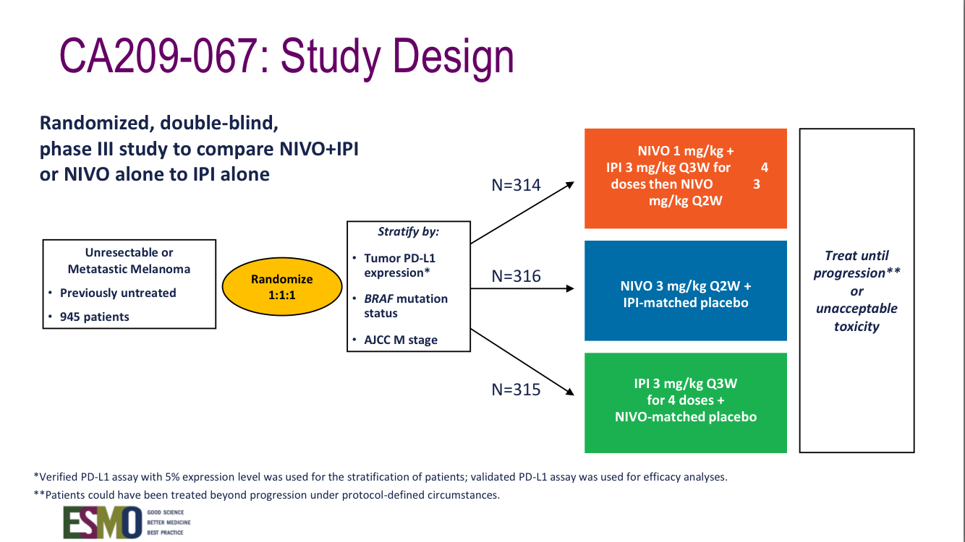

Slide 11
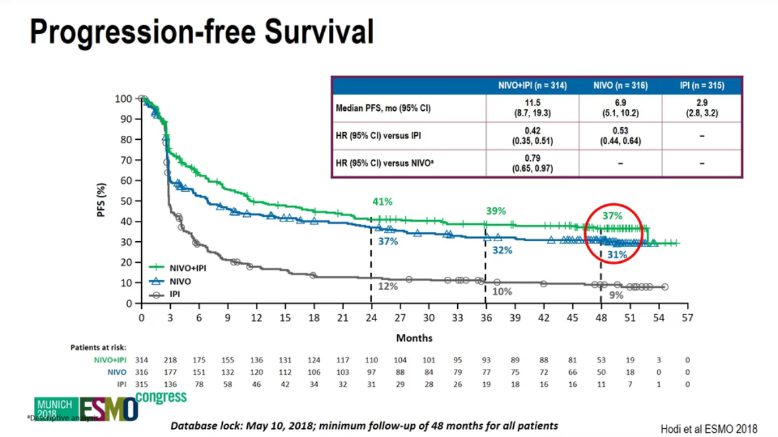

Slide 12
Advanced Melanoma
1- 5 year landmark survivals ipi+nivo vs nivo
2- Dosing regimen of combined ipi+nivo
3- Checkpoint inhibitors + BRAFi + MEKi

Slide 13
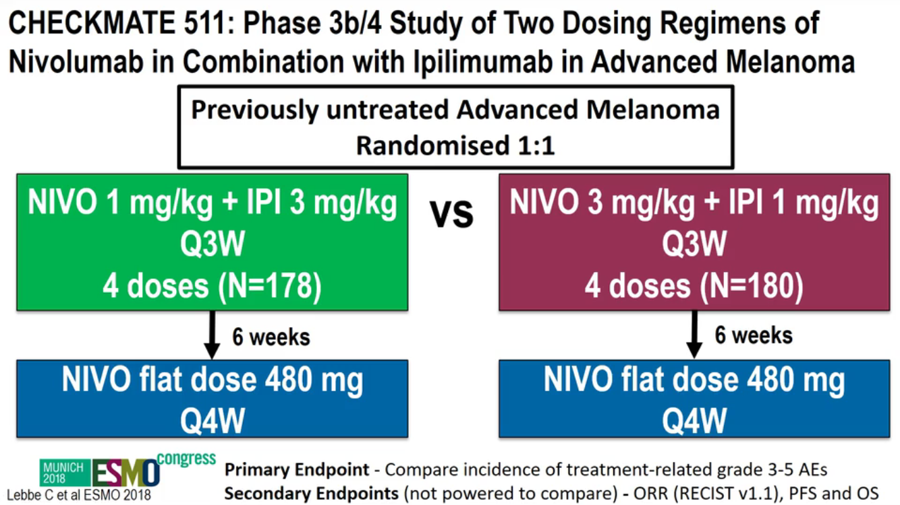

Slide 14
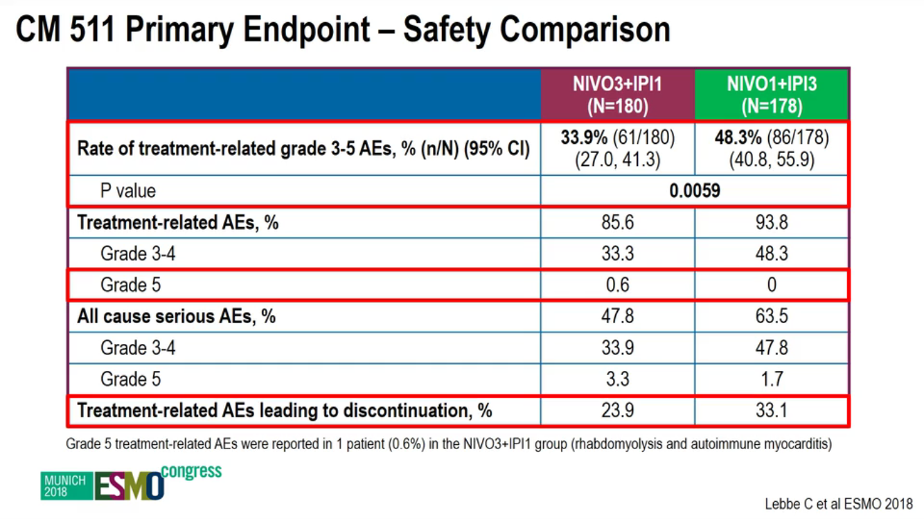

Slide 15
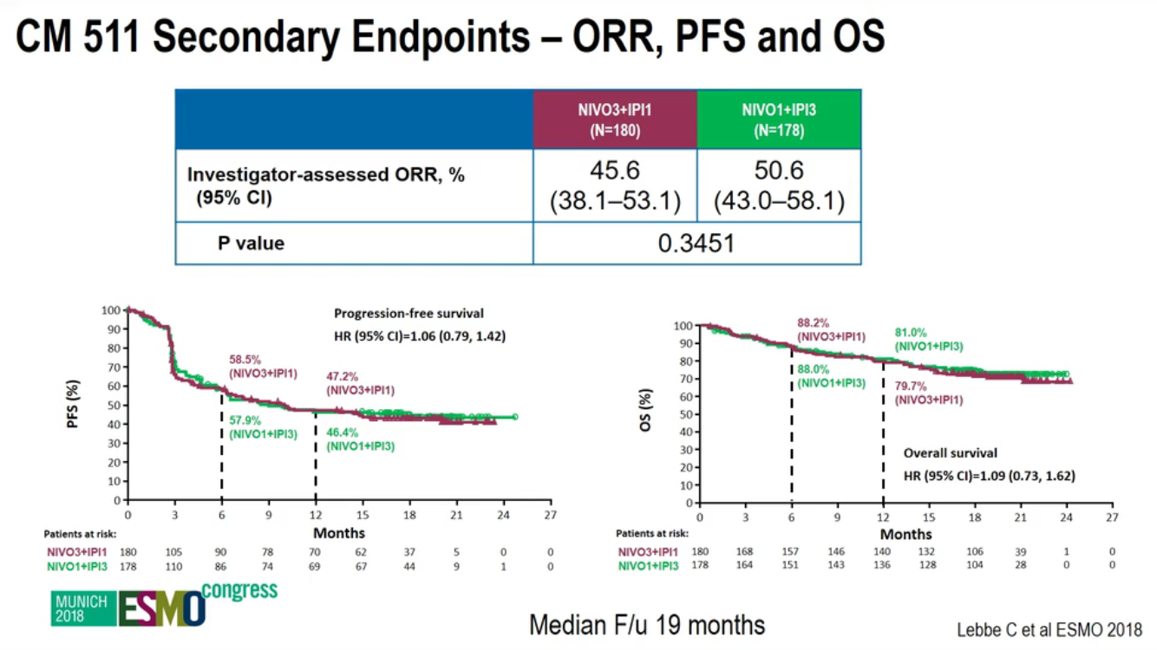

Slide 16
Advanced Melanoma
1- 5 year landmark survivals ipi+nivo vs nivo
2- Dosing regimen of combined ipi+nivo
3- Checkpoint inhibitors + BRAFi + MEKi

Slide 17
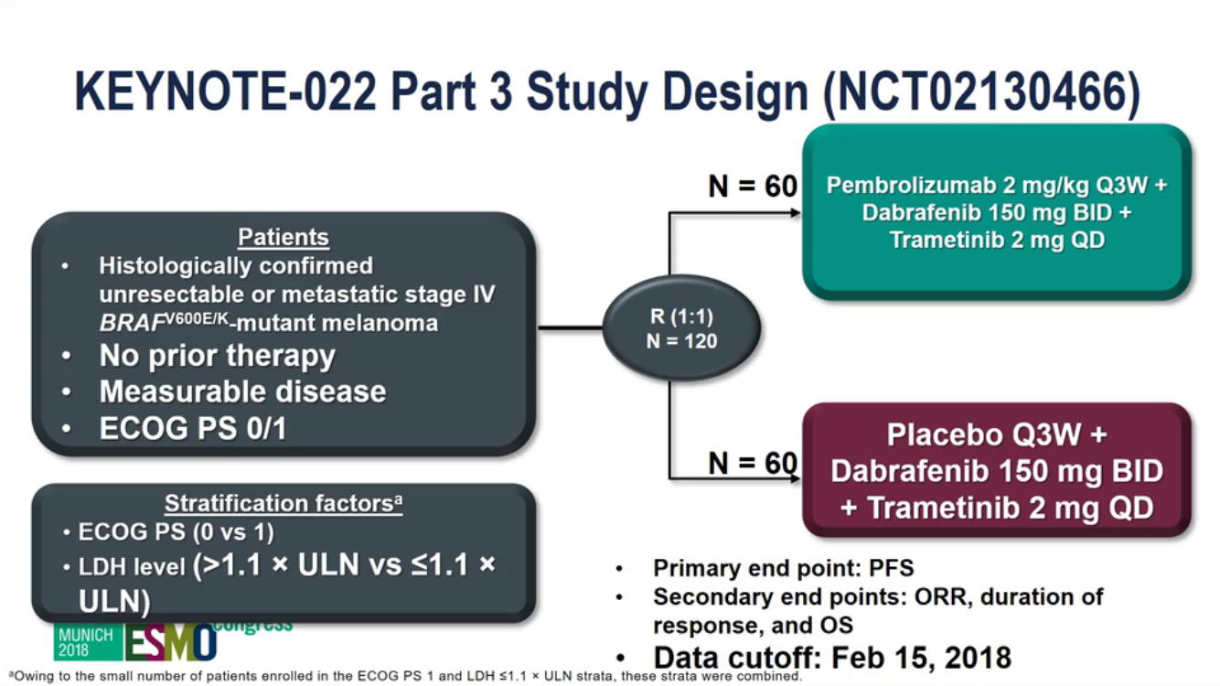

Slide 18
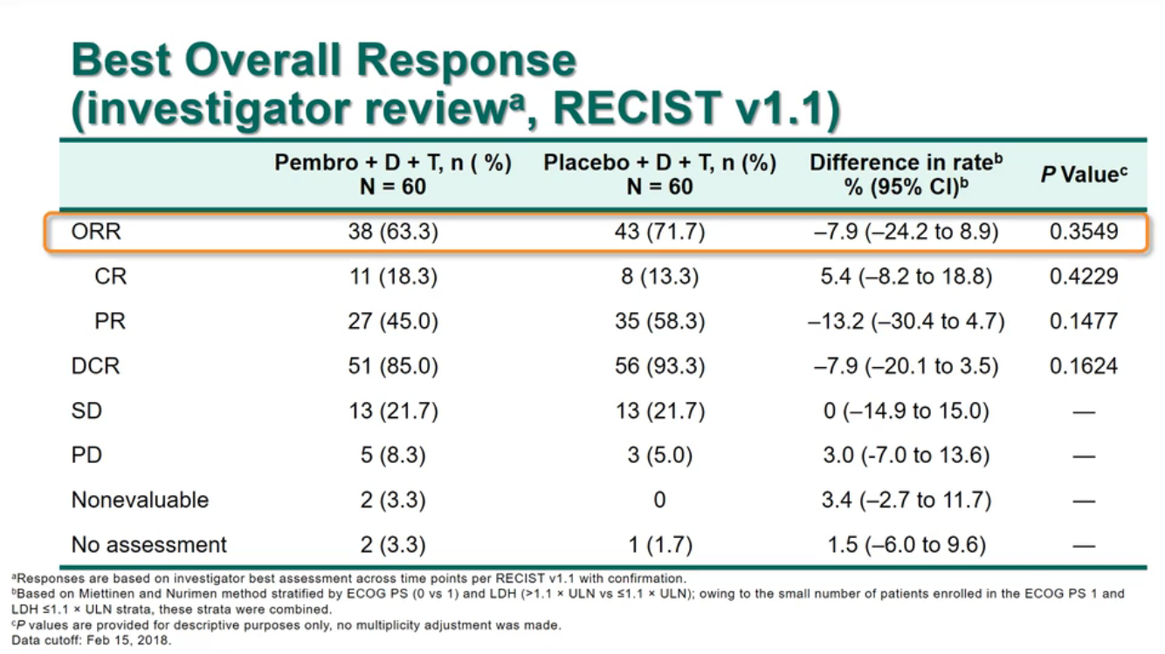

Slide 19
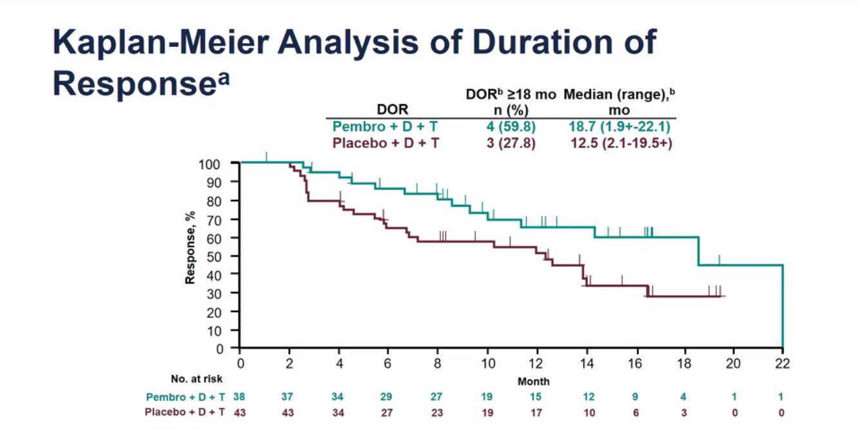

Slide 20
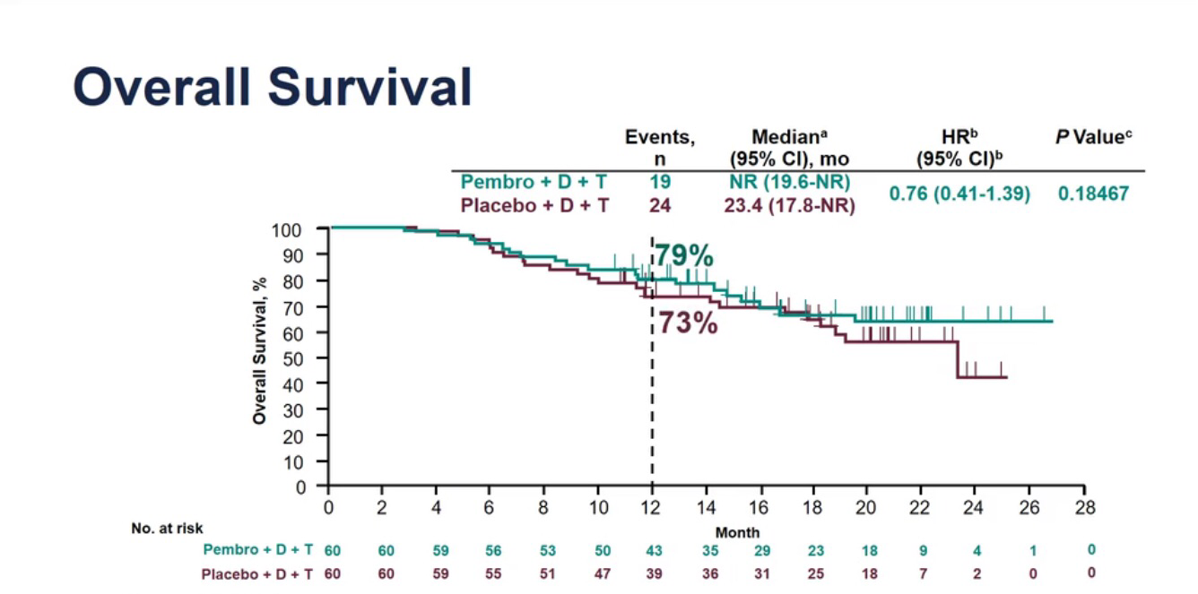

Slide 21
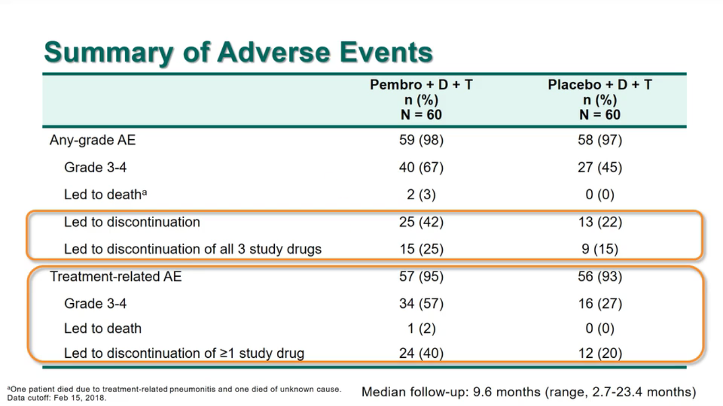

Slide 22
Early Melanoma

Slide 23
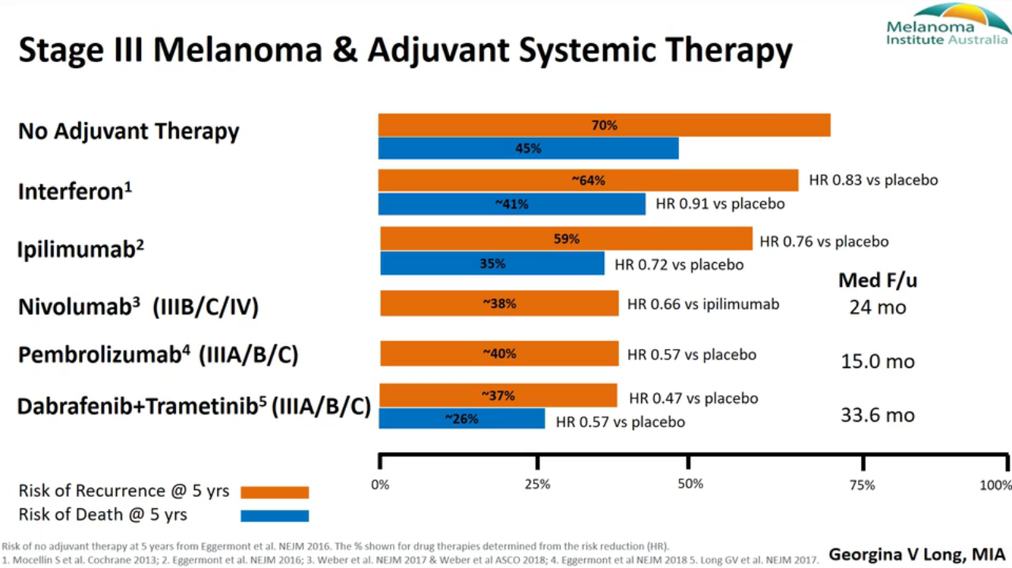

Slide 24
Early Melanoma
1- Adjuvant BRAFi + MEKi
2- Neoadjuvant Checkpoint inhibitors

Slide 25
Early Melanoma
1- Adjuvant BRAFi + MEKi
2- Neoadjuvant Checkpoint inhibitors

Slide 26
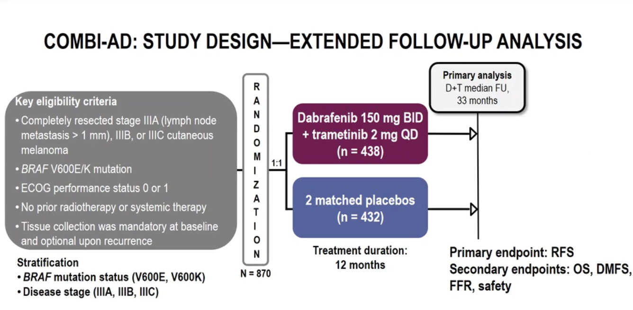

Slide 27
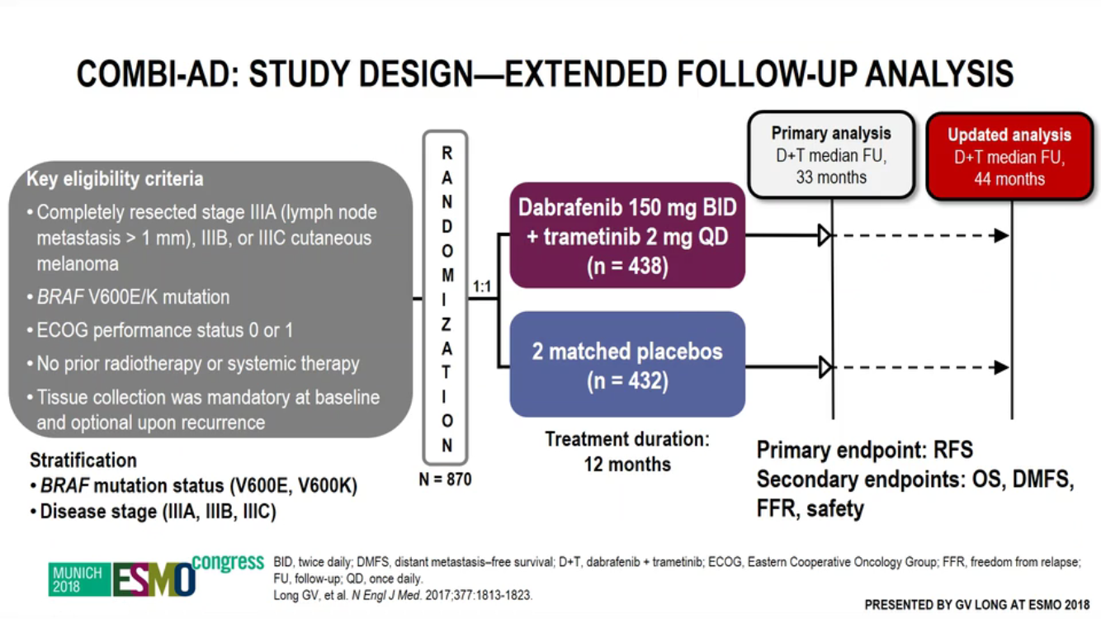

Slide 28
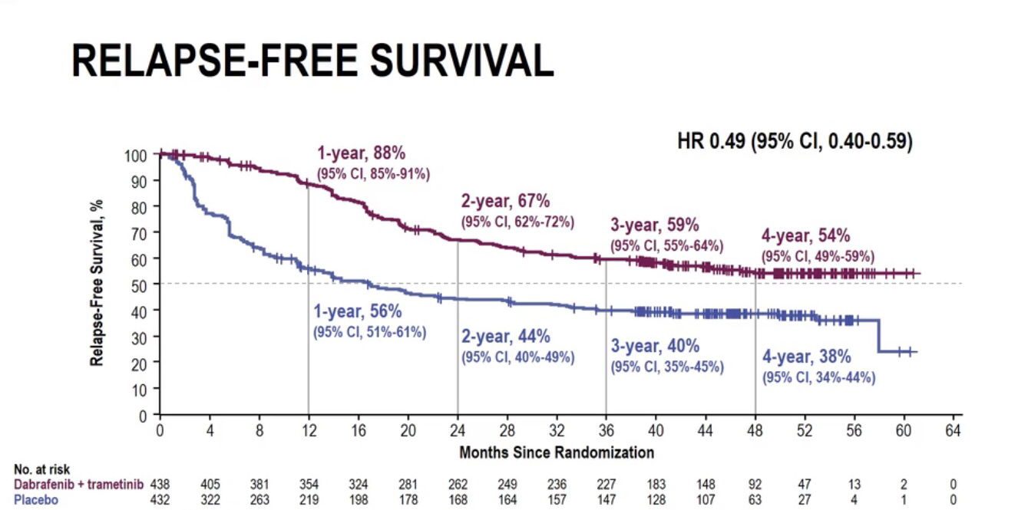

Slide 29
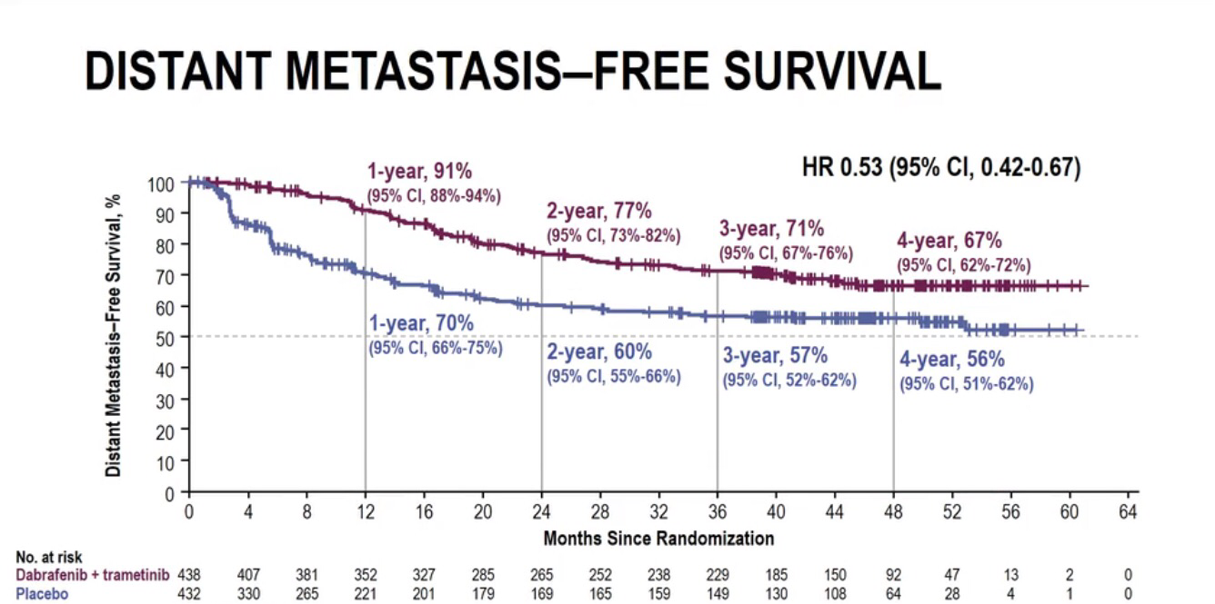

Slide 30
Early Melanoma
1- Adjuvant BRAFi + MEKi
2- Neoadjuvant Checkpoint inhibitors

Slide 31
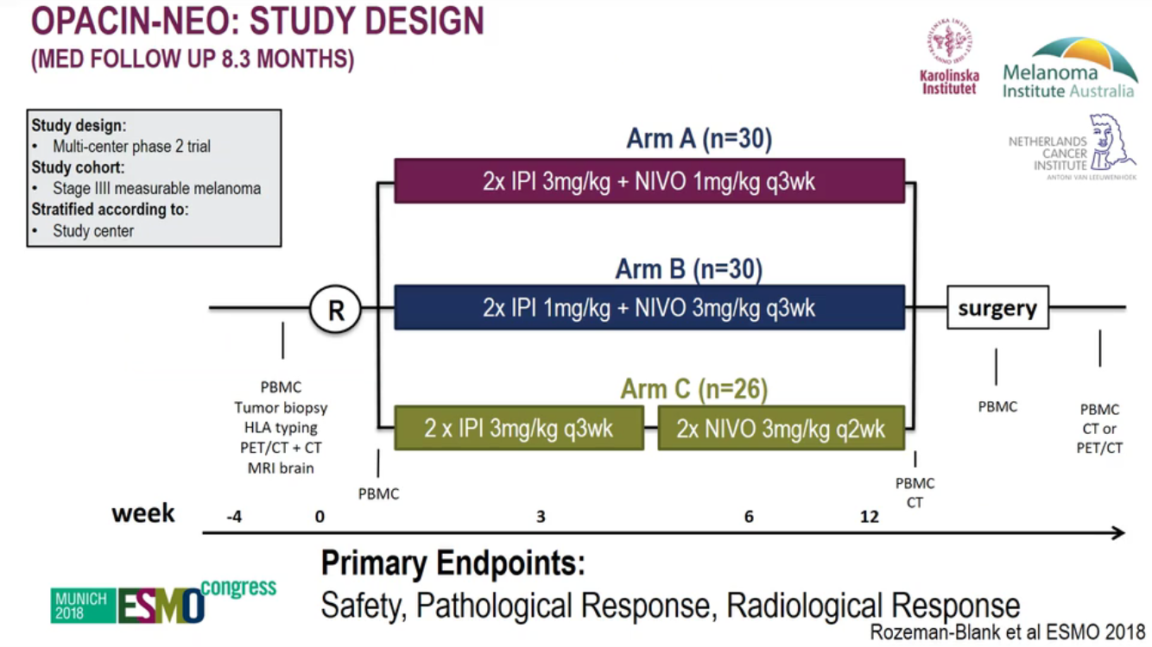

Slide 32
Thank you for your attention

